Slide 1
The Two pizza team rule
By: William Thomason
Web-430
Presentation 2.2

Slide 2

Where it all started
Bigger doesn’t mean better when it comes to work. Jeff Bezos, the CEO of Amazon famously coined this with the 2 Pizza rule
According to Bezos, the ideal is the “two pizza team:” if a team couldn’t be fed with two pizzas, it was too big.
Working with a small, scrappy startup team, I often find myself wishing for more brains on deck to work on cool projects, build more shiny features, and talk with our customers. It’s just natural to believe that larger teams means you’ll get more awesome stuff done, and so much more swiftly — which is why I was taken aback when I learned that throwing more people at a problem is one of the most common productivity traps that you can fall into.

Slide 3
Where it all started
In fact, the conventional wisdom that two heads are better than one — or the more brains you have on a problem the better — is completely wrong. People in smaller teams are far more personally productive.
As group size rises, all sorts of issues spring up. Individual performance levels diminish, and people start to grow less engaged. So while larger teams may be getting more done altogether, it’s happening at a rate lower than the sum of individual efforts.
More people means more of everything — better to great, and more bad and ugly — in rallying a group of human beings to get something done. Even if more people provide a greater pool of resources, they also require greater amounts of coordination and management, to the point where size becomes an impediment.

Slide 4
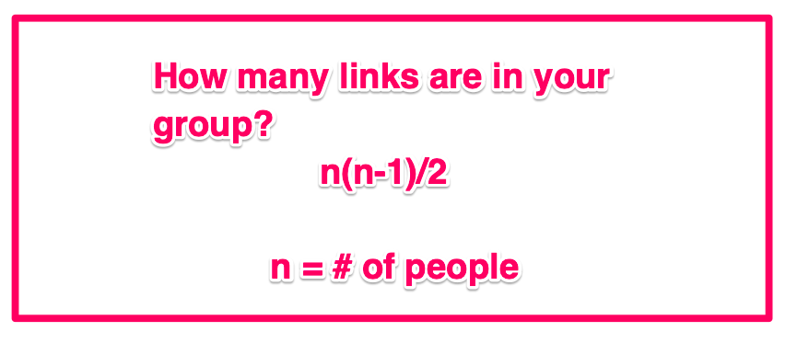
Communication Becomes a Nightmare as Teams Expand
The issue with quickly growing teams isn’t quite the team size itself. As organizational psychologist and expert on team dynamics J. Richard Hackman pointed out, it’s the number of links between people that begins to pose the problem. Look at the formula for determining the number of links between members in a group: n(n-1)/2.

Slide 5
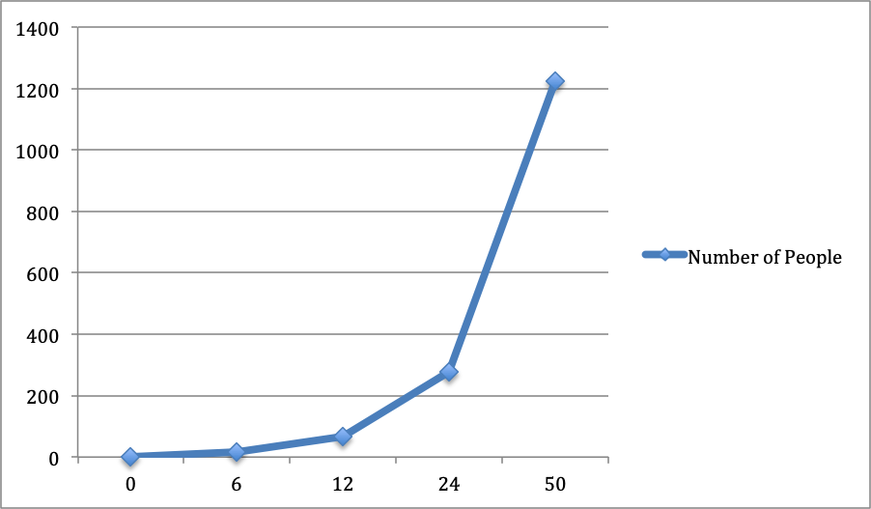
Communication Becomes a Nightmare as Teams Expand
As group size increases, the links start to get unwieldy.
If you take a basic two-pizza team size of, say, six. That’s 15 links between everyone.
Double that group for a team of 12. That shoots up to 66 links.
A small business of 50 people has an incredible 1,225 links to manage.

Slide 6
Communication Becomes a Nightmare as Teams Expand
The cost of coordinating, communicating, and relating with each other snowballs to such a degree that it lowers individual and team productivity. Hackman explained, “The larger a group, the more process problems members encounter in carrying out their collective work …. Worse, the vulnerability of a group to such difficulties increases sharply as size increases.”
You want to be sure that your team is able to remain decentralized and move fast. Breaking into smaller pods as companies scale encourages greater autonomy and creativity.

Slide 7
Two-Pizza Teams Protect Against the Team Scaling Fallacy
Many managers and leaders fall into the mental trap that adding more people to a team is always good — especially in times of expansion. People are your best assets, so adding more assets to a project should power up progress, right?
The fact is, larger team size makes people overconfident. People have a tendency “to increasingly underestimate task completion time as team size grows,” researchers Bradley Staats, Katherine Milkman, and Craig Fox explain. In one of their experiments, they discovered that when tasked to build the same Lego figure, two-person teams took 36 minutes while four-person teams took 52 minutes to finish — over 44% longer. Yet the larger teams were almost twice as overoptimistic about how long they’d take.

Slide 8
Two-Pizza Teams Protect Against the Team Scaling Fallacy
When a project is running behind, you want to get something done faster, or there’s an ambitious milestone at stake, it seems reasonable to add on more people power. Sticking to a max number of a two-pizza team will balance a natural tendency to underestimate the costs and friction of dealing with those extra links.

Slide 9
References
Choi, J. (2016, March 22). Jeff Bezos' 2 Pizza Rule: Why Small Teams Work More Productively. Retrieved July 21, 2019, from https://buffer.com/resources/small-teams-why-startups-often-win-against-google-and-facebook-the-science-behind-why-smaller-teams-get-more-done
Choi, J. (2018, December 06). The Science Behind Why Jeff Bezos's Two-Pizza Team Rule Works. Retrieved July 21, 2019, from http://blog.idonethis.com/two-pizza-team/

Slide 10
Thank you for joining!
William@williamthomason.info
https://github.com/wthomason

